Slide 1

Happiness Index Report
Name: Carla Bradley
Course: Data Exploration and Analysis
Professor: Matthew Metzger

Slide 2
Problem Statement
Millions of citizens of the world have lost their jobs. They have watched helplessly as their savings dwindled, as they were confined to their homes—prohibited from interacting with friends, attending church, temple or music, and sporting events due to restrictions enacted in response to the COVID-19 pandemic. These situations have incremented the statistics and indices related to depression and suicide.
My project is to identify the societal factors that the government will need to focus on for bringing society together to produce a sense of relief and happiness.
The Happiness Index is a valuable resource for determining the societal factors that influenced a country's happiness index before and after the COVID-1 9 pandemic.

Slide 3
Analysis
How much did the worldwide pandemic of 2020 impact a country’s ranking from 2019 to 2020?
Does more GDP really make a country happier? (Gross Domestic Product per capita)
What’s the variables that drive a higher happiness score?
Which of the societal variables contributed the most to a continent to be among the “happiest” and “unhappiest” 2020?
Does freedom of life provide a country with happiness?

Slide 4
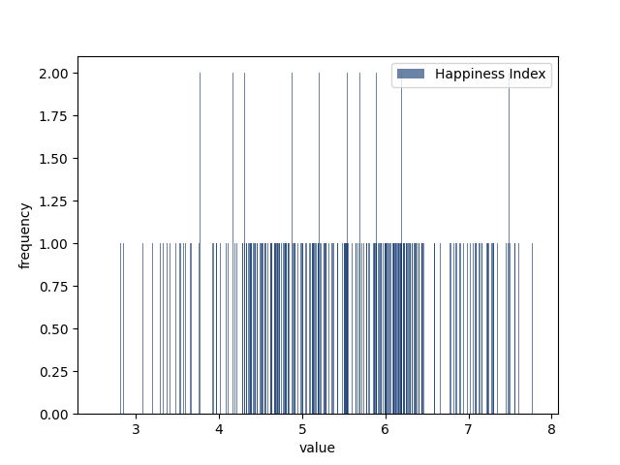
Happiness Index Histogram
The happiness index mean is 5.4, and the median is 5.5.
The data appear to be symmetrical distributional with variance value is 1.23

Slide 5
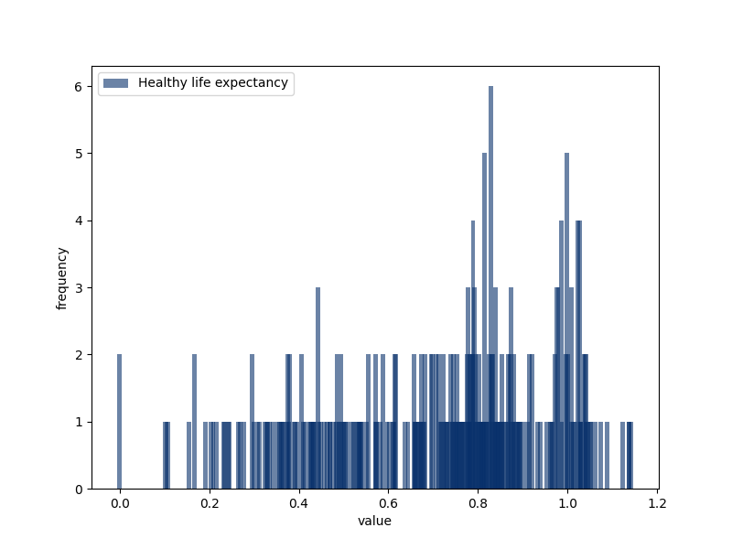
Healthy Life Expectancy Histogram
The Healthy life expectancy index mean is 0.711, and the median is 0.777.
The data appears to be skewed to the left distributional and variance value is 0.061

Slide 6
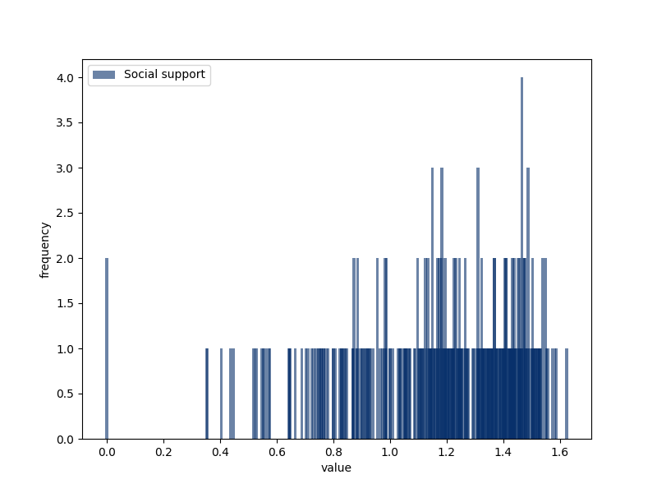
Social Support Histogram
The Social support index mean is 1.185, and the median is 1.237.
The data appear to be skewed to the left with a variance value is 0.084

Slide 7
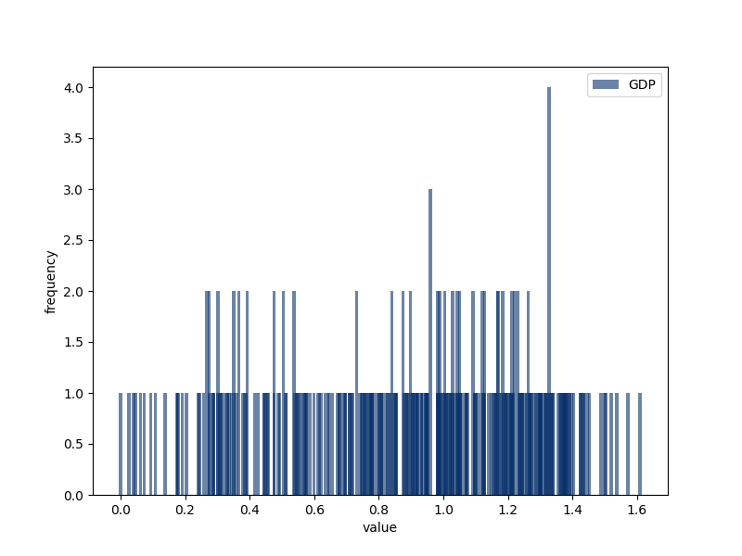
GDP Histogram
The GDP index mean is 0.9, and the median is 0.94.
Data appears to be skewed to the left with a variance value is 0.145

Slide 8
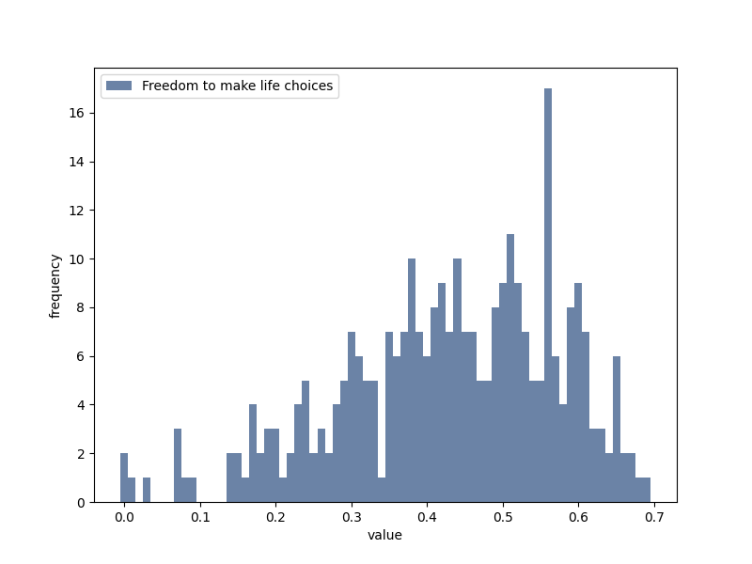
Histogram Freedom to Make Life Choices
Freedom to make life choices index mean is 0.429, and the median is 0.440.
The data appear to be skewed to the left distributional and variance value is 0.021

Slide 9
Summary
I combined two data frames from the index's surveys from 2019 and 2020. I ensure that the variables match and remove incompatible variables, identified the missing values, outliers, unusual distributions.
Missing Values/Outliers
The data set has 12 variables with zero values that could be defined as either outlier, missing values, or errors. Considering it is a minimal amount of missing values, I overlooked this fact in the analysis because I don't consider that will influence the analysis's conclusion.
Variables
Country or region - Geography location.
Regional indicator - Continent
Ladder score - Happiness level.
Social support - The sense of social support of the individuals.
Healthy life expectancy - Life expectancy.
Freedom to make life choices - The sense of social freedom to make life choices.
Generosity - Generosity
Perceptions of corruption -The perception of corruption of individuals.

Slide 10
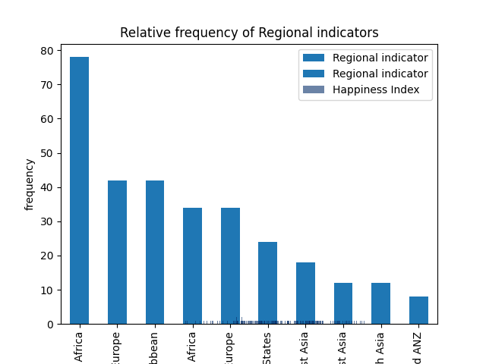
Histogram
reflects relative frequency distribution of Regional indicator

